Slide 1
Mariana Islands Nature Alliance
General Membership Meeting
Chair’s Report
May 7, 2009
Est. 2005

Slide 2
MINA’s Mission
To conserve and restore the array of habitats that sustains our natural biodiversity and heritage for today and tomorrow

Slide 3
Who’s MINA?
9- Board Member 501(c)(3) Organization
Comprised of nearly 100+ members and organizations dedicated to the conservation of the diverse natural and cultural resources of the Commonwealth of the Northern Mariana Islands
Over 60 years experience in resource management combined
Members of Beautify CNMI and Friends of the Monument

Slide 4
Progress on 2007-2009 Strategic Plan
Issue | Goals | Objectives | Projects
Meeting the Micronesia Challenge | Educate the public on existing land use and marine practices, promoting better community stewardship. | -Conduct and develop a “More fish, less pollution” campaign -Increase by 50% the general public’s knowledge and understanding of the CNMI’s rules and regulations used to manage the marine resources. | -Identify and target significant stakeholder marine resources user groups for a “more fish, less pollution” outreach and education program. -Conduct in 2008 a teacher training camp and a kids summer camps.
Solid Waste | Clean beaches and reduction of solid waste. | Coordinate (via MINA staff & volunteers) with Beautify CNMI! coalition “leads” on solid waste reduction activities. | Identify beaches for adoption; solicit community members, businesses and legislators to donate trash removal for area beaches; provide educational signage at beaches. -Marine Debris Project

Slide 5
Progress on 2007-2009 Strategic Plan
Issue | Goals | Objectives | Projects
Building MINA’s capacity | Improve financial stability Improve Evaluations and Reporting of MINA’s Strategic Plan progress to membership. | Develop a strategy to market MINA. Increase MINA’s public awareness and public involvement. Increase MINA general membership to 200 individuals by the end of strategic planning session in 2010. Develop and implement a fundraising strategy. Communicate to MINA’s membership a better understanding of membership fees and activities | Conduct membership events for recruiting at least 25 new members per year, obtain corporate-business membership and to retain 80% of current members. Seek and secure 2 grants / year. (funding in the $10,000 to $50,000 range.) Conduct 2 fundraising events / year. Establish 5 new business partnerships within 2 years. Exec. Dir. will communicate MINA goals quarterly and annually via an expanded dynamic web site. This website will be in place and accessible to all MINA BOD and EXEC DIR by March 31, 2008. In November 2009 conduct MINA’s 3rd strategic planning meeting, Ex. Dir. will report progress on 2008 - 2010 strategic plan and BOD along with general membership will create a 2010 – 2012 strategic plan.

Slide 6
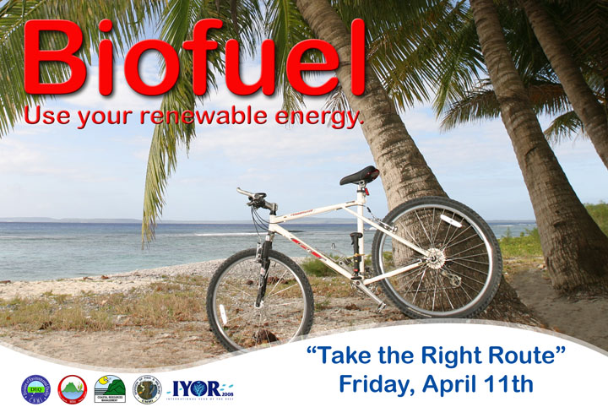
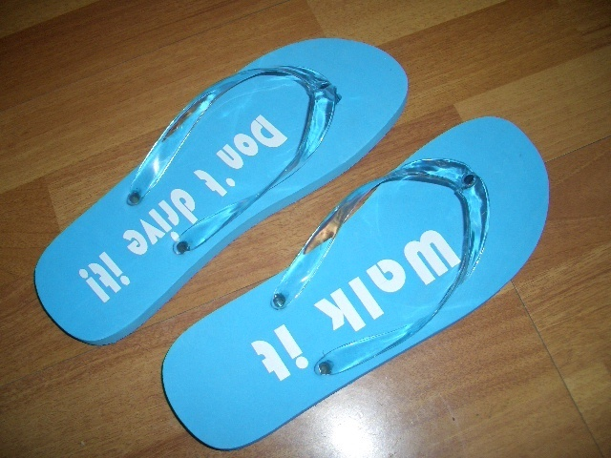
Take the Right Route
Goal: Reduce carbon footprint
Public Outreach
Designed “Walk it, Don’t Drive it” flipflops
Need #’s

Slide 7
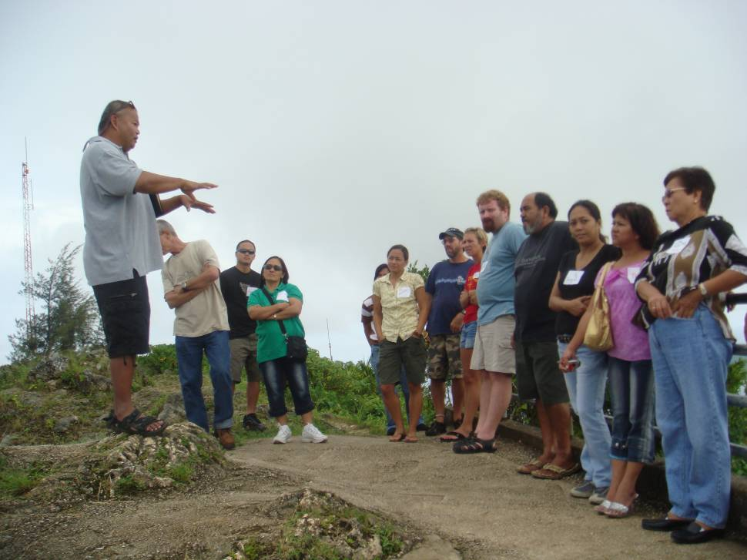
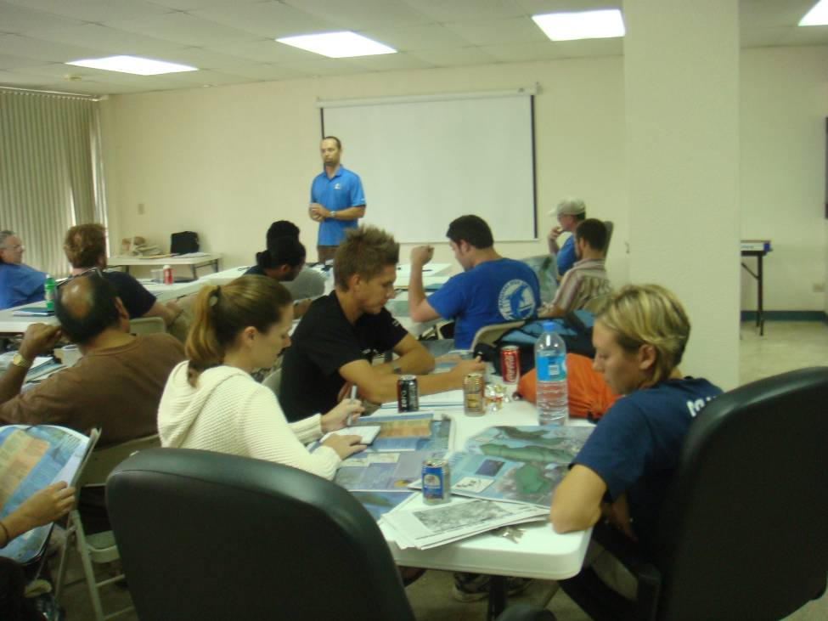
Teacher Camp 2008
GOALS
Introduce teachers to basic coral reef ecology principles
Explore the benefits of reefs
Understand human impacts on reefs
Raise awareness of how individuals can mitigate their impact on our reefs

Slide 8
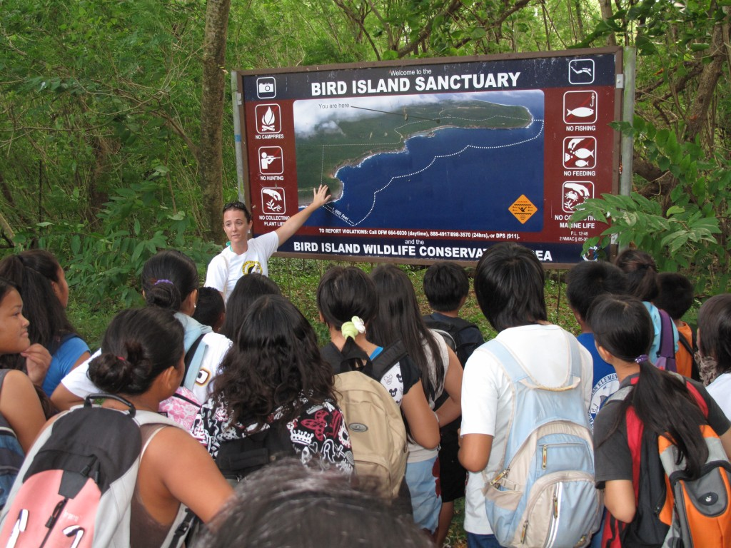
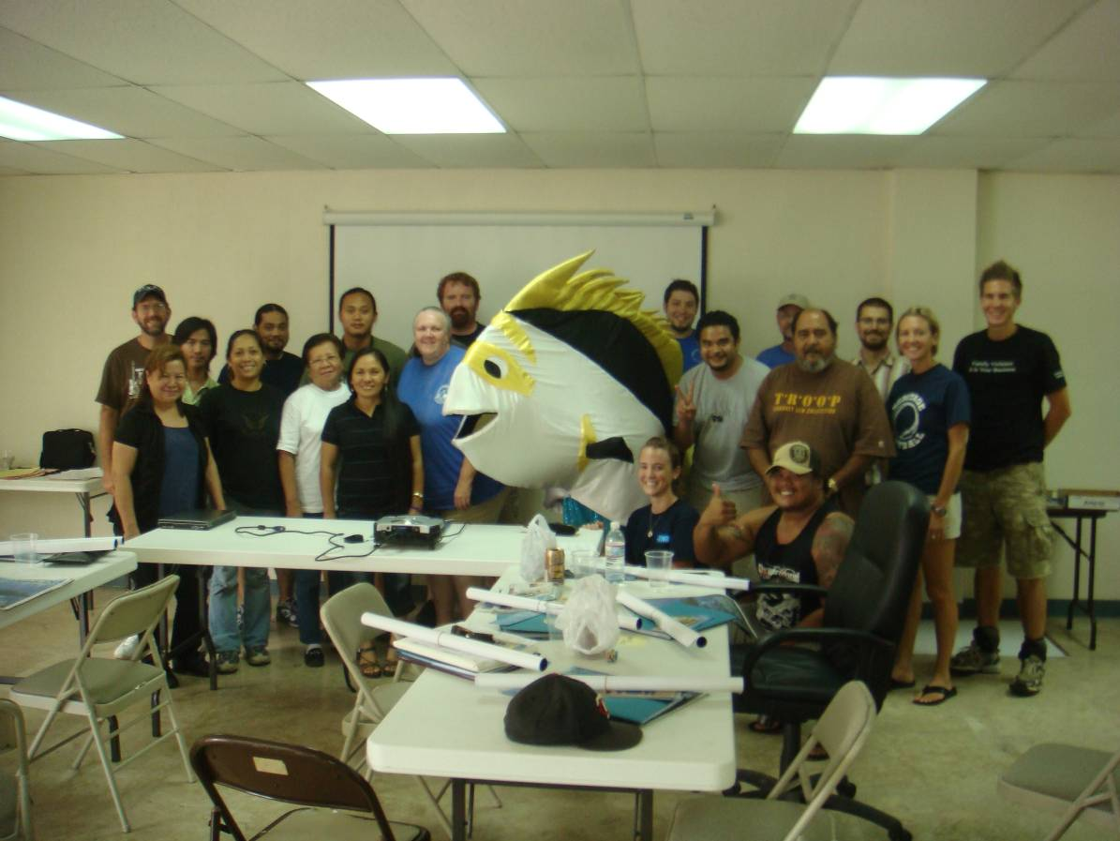
Teacher Camp
OUTCOMES
24 teachers, 18 lesson plans and 6 field trip plans
Incorporated coral reefs into a variety of subjects in classrooms throughout the CNMI.
Resources available to teachers for coral reef related lessons and activities

Slide 9
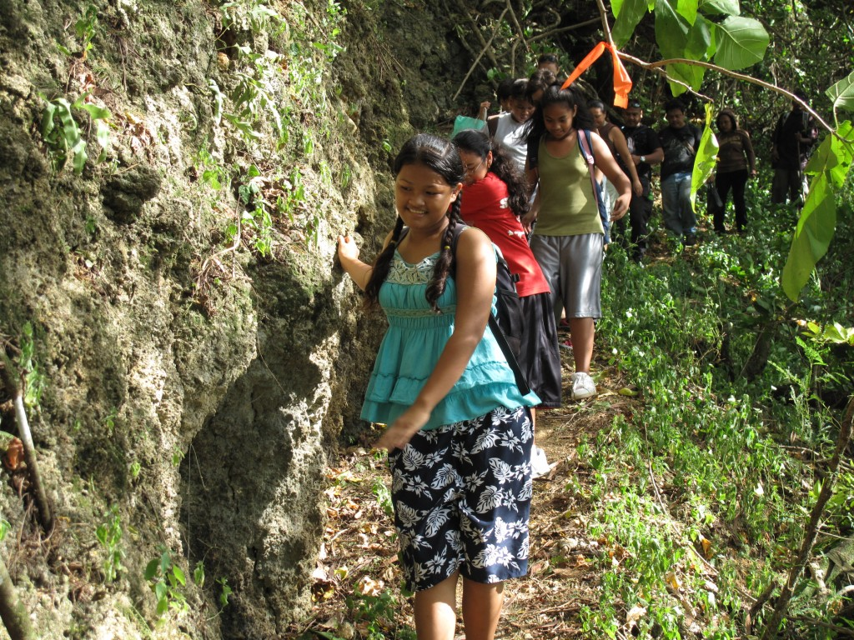
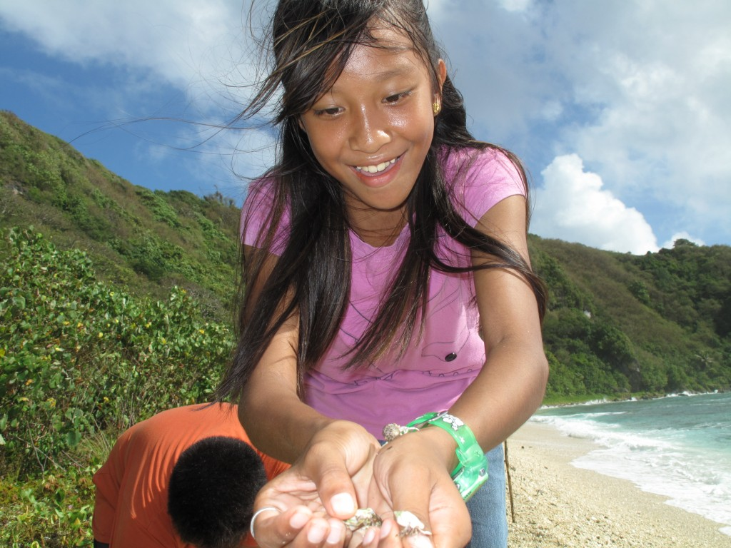
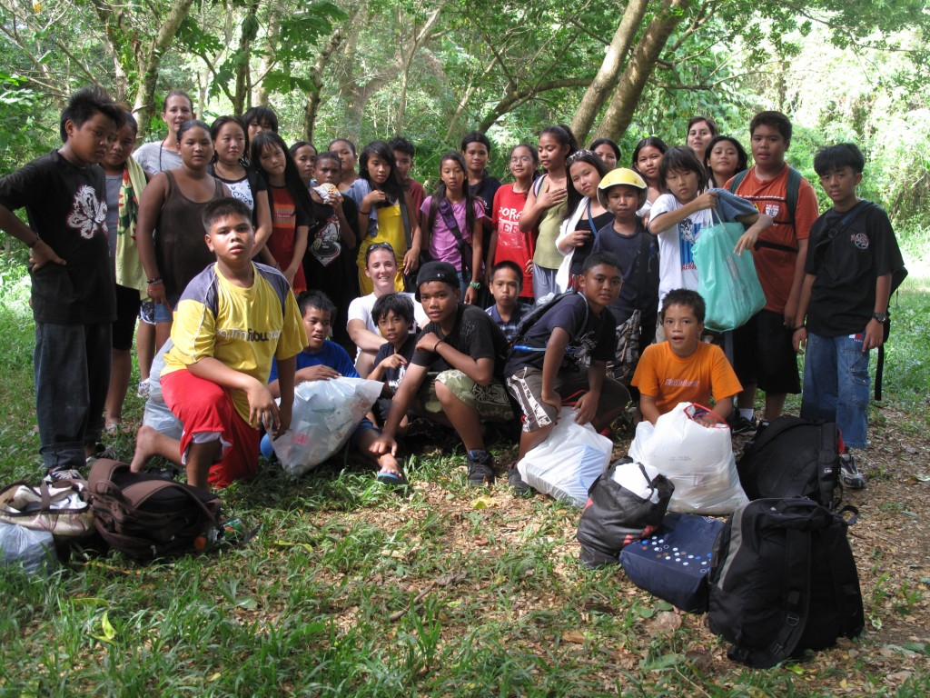
Teacher Camp 2008
Support from Light in the Eve and
Grant from Dept. of Interior-Office of Insular Affairs
20 Teachers
36 Lesson Plans
2700 students

Slide 10
Partnerships
CRM – Rare Pride Campaign
DEQ – Talakhaya Restoration Project
- Mentoring
- Financial
- Promotion
Micronesians in Island Conservation
The Nature Conservancy

Slide 11
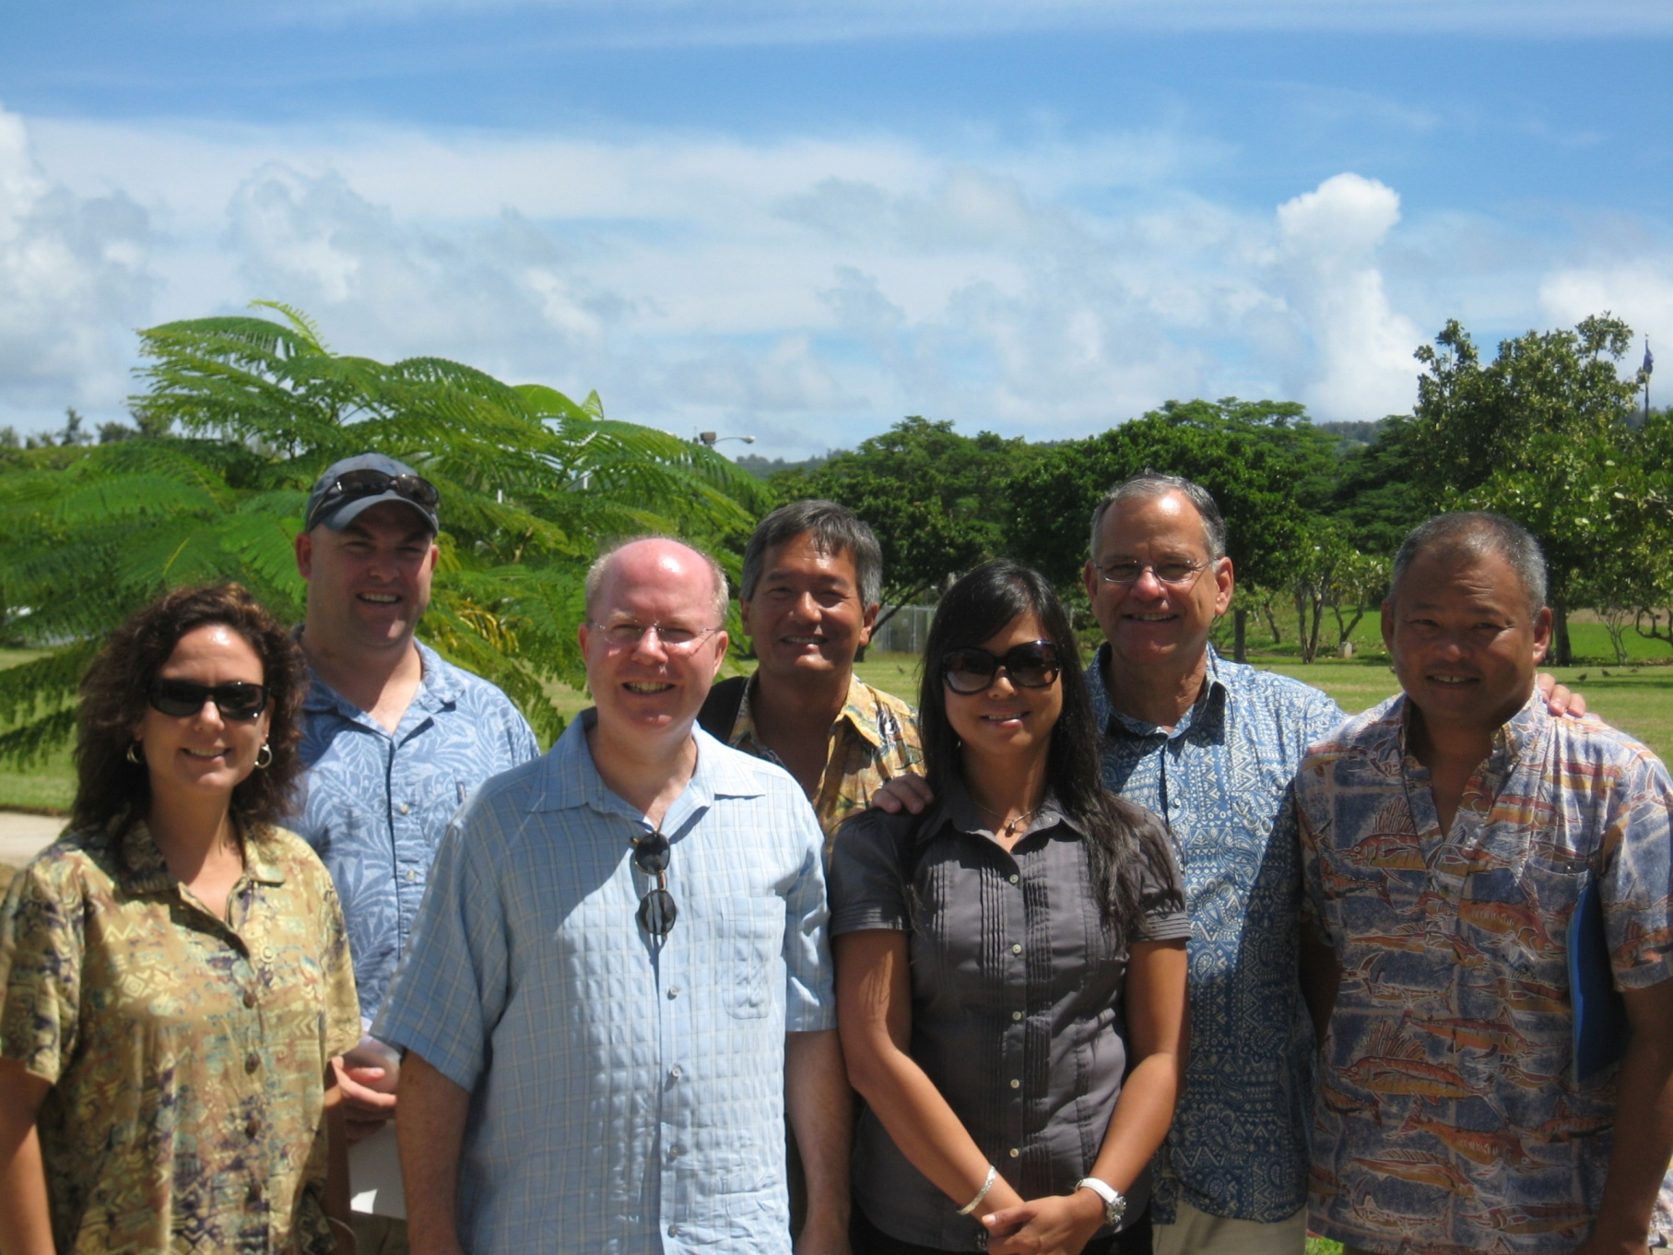
Meeting with CEQ and NOAA

Slide 12
Upcoming Projects

Slide 13
Marine Debris Project
Goal: Reduction and Prevention of marine debris
Purchase (6) industrial size recycle bins
Place in high traffic beach/dive sites
-Laolao Bay (2)
-Obyan (1)
-13 Fishermen area
- Garapan Fishing Dock
- Sugar Dock
Partner with local businesses to adopt bins

Slide 14
Community Action for Renewed Environment (CARE)
Applied for a CARE grant
Community-based conservation advocacy group
Expand efforts to stop pollution
Increase awareness
Received overwhelming support from
-Congressman Kilili
-Government agencies
Notes:
(CA

Slide 15
Job Opportunities
Executive Director (1/2 time)
Two (2) Project Managers
Financial Manager (1/2 time)
Student Intern (10 weeks for 2 summers)

Slide 16

Carbon Offsets at Pacific Islands Environment Conference
Purchase carbon offsets when you register for PIEC at www.regonline.com/piec2009
Proceeds will go to MINA towards a revegetation effort in the Laolao Bay Watershed

Slide 17
Other Projects
Teacher Camp 2009 – Saipan & Tinian
2010-2012 – Strategic Action Plan
Continue supporting Talakhaya Project

Slide 18

Announcements
Join MINA or renew your memberships with Paypal
New Office - Located at YCO HK Building next to
Naked Fish Bar and Grill
Tel: 670.233.REEF (7333)
Website: www.minapacific.org
New Logo

Slide 19
Acknowledgements
Ms. Misako Kimata and Mr. Horiguchi
Mr. Joseph Torres
Joeten Enterprises
Pacific Trading Company
Triple J Corporation
Marpac Distributors
Ms. Ginny Salas

Slide 20



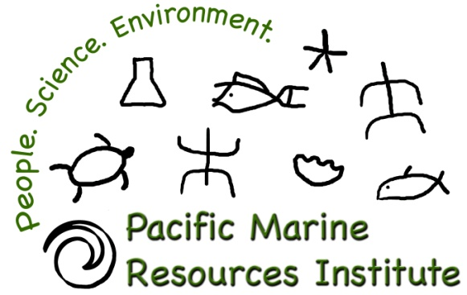

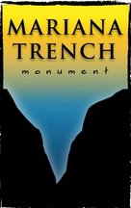






Thank You
Dept. of Public Lands
Dept. of Lands & Natural Resources
DPW Solid Waste

